Slide 1
Lecture 2 Structure in C and C++ Class Object Programming Example A.S.M Delwar Hossain Lecturer CSE,VU
Object Oriented Programming /C++

Slide 2

Simple Example:
#include <iostream>
using namespace std;
void main()
{
cout << "Enter number 1: ";
int a;
cin >> a;
cout << "Enter number 2: ";
int b;
cin >> b;
int s = a + b;
cout << "Sum = " << s;
}
Output

Slide 3
Structures Revisited
Makes convenient to handle a group of logically related data items.
struct student //declaration
{
char name[20];
int roll_number;
float total_marks;
};
struct student A;// C declaration
student A; //C++ declaration
A.roll_number=999;
A.total_marks=595.5;
Final_Total=A.total_marks + 5;

Slide 4
C Structures limitation
Limitations in C
No constructors and destructors.
They do not permit data hiding.
Structure does not support the inheritance.
Advantages in C++
Can hold variables and functions as members.
Can also declare some of its members as ‘private’.
C++ introduces another user-defined type known as ‘class’ to incorporate all these extensions.

Slide 5
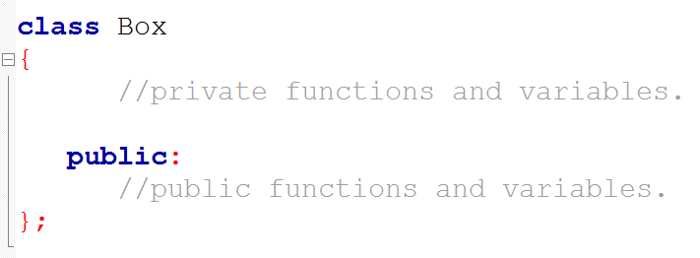
Class: How to declare?
A class definition starts with the keyword class followed by the class name;
and the class body, enclosed by a pair of curly braces.
A class definition must be followed either by a semicolon or a list of declarations.
Access Specifiers

Slide 6
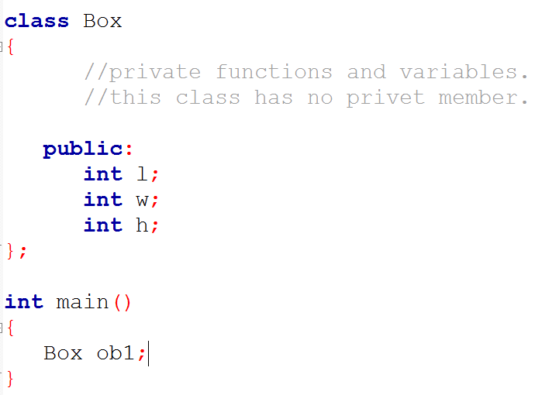
Class: Example
Functions and variables declared inside a class declaration are said to be members of this class.
Object of class Box

Slide 7
Properties of Class
Class members that have been declared as private can be accessed only from within the class.
Public class members can be accessed from outside the class also.
Supports data-hiding and data encapsulation features of OOP.

Slide 8
Object
Object is the actual run time entity which holds data and function that has been defined in the class.
Object declaration:
class_name obj1;
class_name obj2,obj3;

Slide 9
Class and Object
Accessing class members
Object-name.function-name(actual-arguments);
obj1.setdata(100,34.4);
Defining Member Functions
Outside the class definition.
return-type class-name::function-name (argument declaration)
{
Function body;
}
Inside the class definition.
Same as normal function declaration.

Slide 10
Object as arrays
class employee
{
char name [30];
float age;
public:
void getdata(void);
void putdata(void);
};
employee manager[3];//array of manager
employee worker[7];//array of worker
Manager[i].putdata();

Slide 11
Access Specifiers: private and public
Variables or functions declared after access specifier private accessible only to member functions of the class.
Variables or functions declared after access specifier public accessible both by other members of the class and other part of the program that contains the class.
Protected - Data members and functions are available to derived classes only.
The default access for class members is private.
Declaring data members with access specifier private is known as data hiding. (encapsulation)

Slide 12
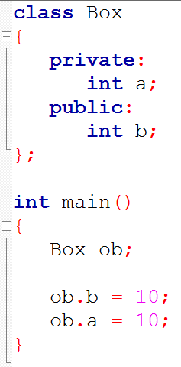
Public, Private
Private variable of class Box.
Public variable of class Box.
No problem, you can access a public variable through objects of that class.
Problem, private variables can access only through member functions of that class..

Slide 13
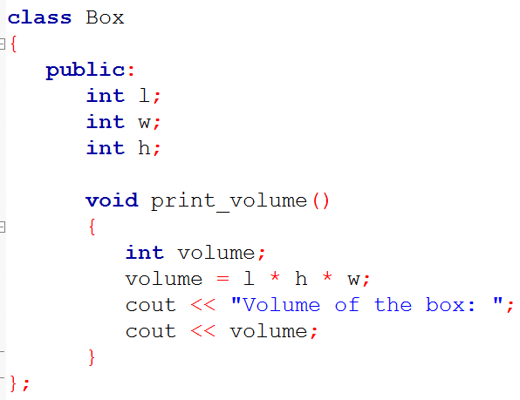
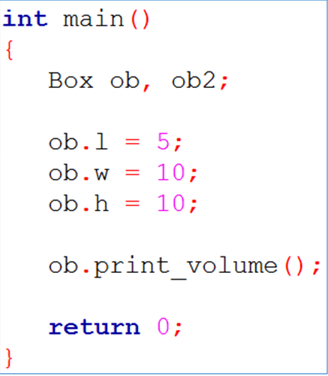
Class with member function
Definition:
Function that are declared to be part of a class are called member function of that class.

Slide 14
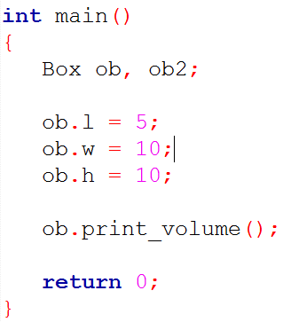
ob
ob2
Each object of a class has its own copy of every variable declared within the class.
l
w
h
Print_volume
l
w
h
Print_volume

Slide 15
ob
ob2
l
w
h
Print_volume
l
w
h
Print_volume

Slide 16
ob
ob2
l
w
h
Print_volume
l
w
h
Print_volume

Slide 17
ob
ob2
l
w
h
Print_volume
l
w
h
Print_volume
5

Slide 18
ob
ob2
l
w
h
Print_volume
l
w
h
Print_volume
5
10

Slide 19
ob
ob2
l
w
h
Print_volume
l
w
h
Print_volume
5
10
10

Slide 20
ob
ob2
l
w
h
Print_volume
l
w
h
Print_volume
5
10
10

Slide 21
ob
ob2
l
w
h
Print_volume
l
w
h
Print_volume
5
10
10

Slide 22
ob
ob2
l
w
h
Print_volume
l
w
h
Print_volume
5
10
10

Slide 23
ob
ob2
l
w
h
Print_volume
l
w
h
Print_volume
5
10
10

Slide 24
ob
ob2
l
w
h
Print_volume
l
w
h
Print_volume
5
10
10
500

Slide 25
Member function with Scope resolution operator ( :: )
Return type of the function.
Class name
Scope resolution operator ::
Function name with parameter list.
Function body between {}
return_type class_name :: function_name()
{
//function body.
}

Slide 26
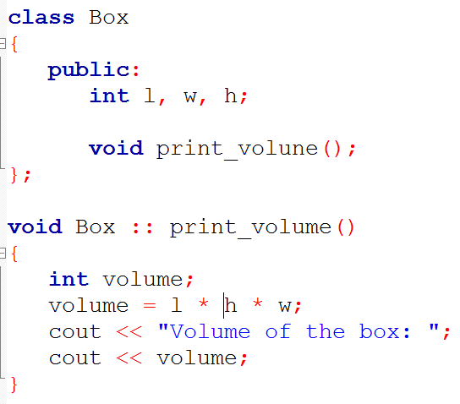
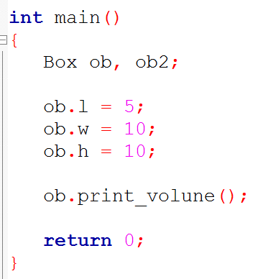
Member function with Scope resolution operator

Slide 27
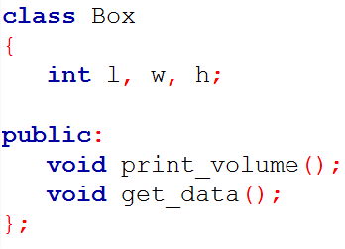
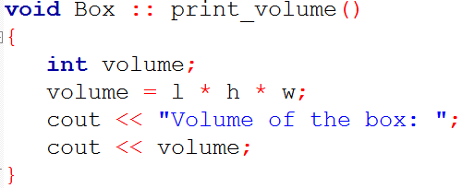
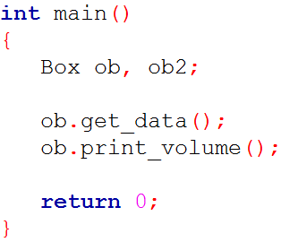
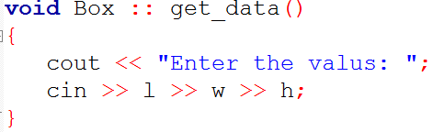
Dealing with private data
It is common practice to declare all variables as private and functions as public.

Slide 28
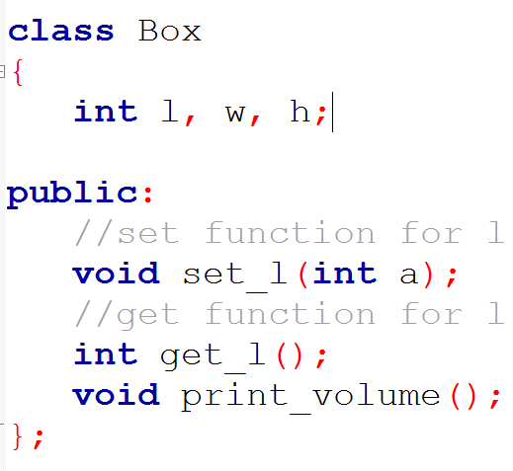
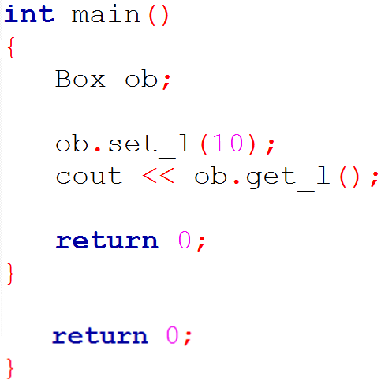
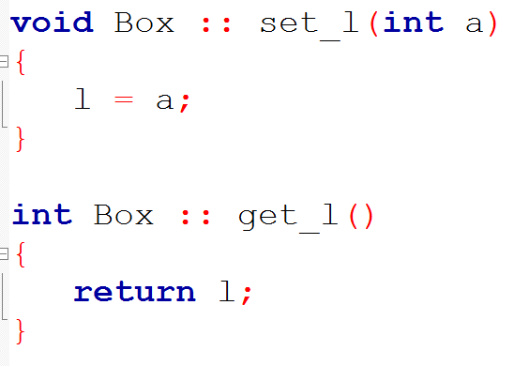
Example: Function with parameter

